Slide 1
LLM: The Art of Language Understanding
GPT vs BERT
© 2024 Jongchul Lee, Department of Statistics, Pusan National University. All rights reserved.
Unauthorized reproduction, distribution, or use of this material is prohibited.
202482123 이종철

Slide 2
Contents
01 Introduction
02 Fine-tuning in NLP
03 GPT-1
04 BERT
05 Applications of GPT & BERT

Slide 3
1. Introduction

Slide 4
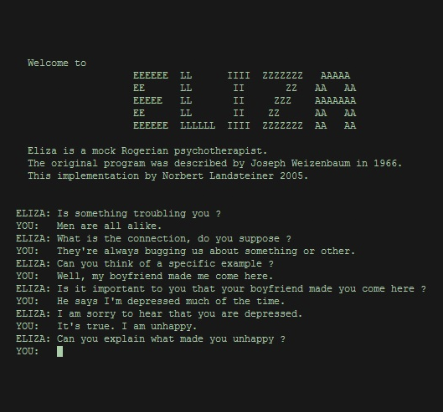
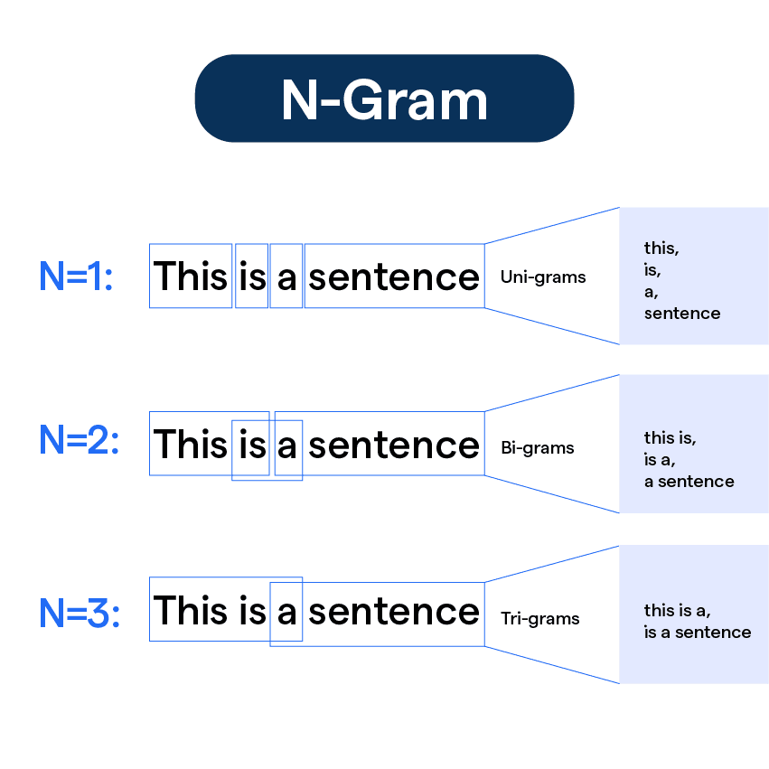
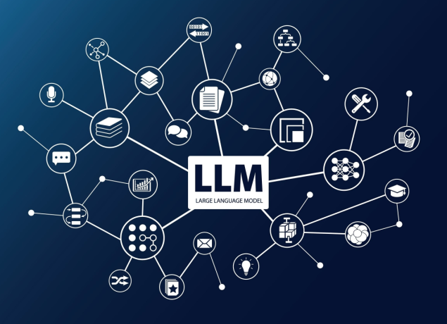
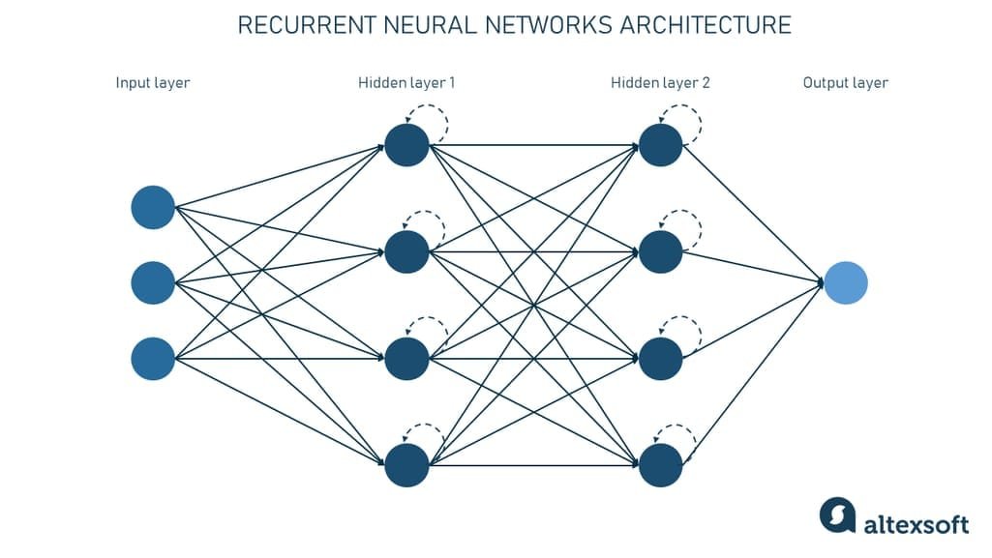
The rise of LLM
The evolutionary journey of the language model
1950s - 1980s
1980s - 1990s
2000s - 2010s
2018 -
Rule-based
Data-based
ML & DL
LLM

Slide 5
2. Fine-tuning in NLP

Slide 6
What is fine-tuning?
Pre-training & fine-tuning
MODEL
MODEL
- classification
- regression
...
Pre-trained
weights
Pre-training
Fine-tuning
Large dataset
New dataset

Slide 7
Semi-supervised sequence learning
Semi-supervised Sequence Learning (Google, 2015)
Key point: Pre-training LSTM with unlabeled sequence data
Step1. Self-supervised learning
Step2. Fine-tuning for current task
Be
happy
<eos>
positive
LSTM
LSTM
LSTM
LSTM
LSTM
LSTM
<sos>
Be
happy
I
love
you

Slide 8
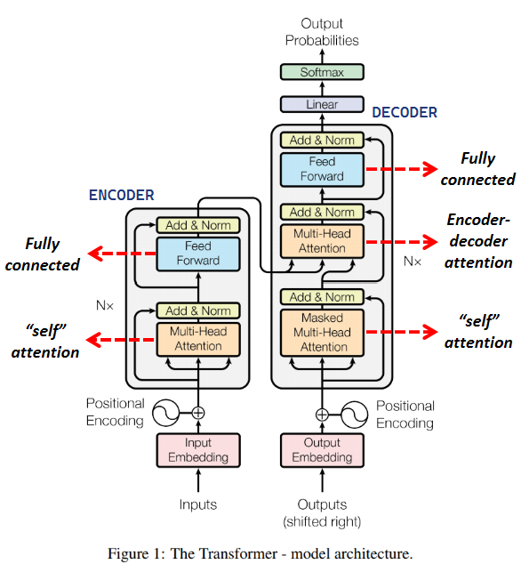
The rise of transformer
Attention Is All You Need (Google, 2017)
Transformer architecture
Masked self-attention in decoder
Contextualized Input
am
<Embedding vector of “am”>
(0.3 x I) +
(0.7 x am) +
(0 x groot) +
self-attention
Future
Masking
am
<Contextualized vector of “am”>

Slide 9
3. GPT-1
(OpenAI, 2018)

Slide 10
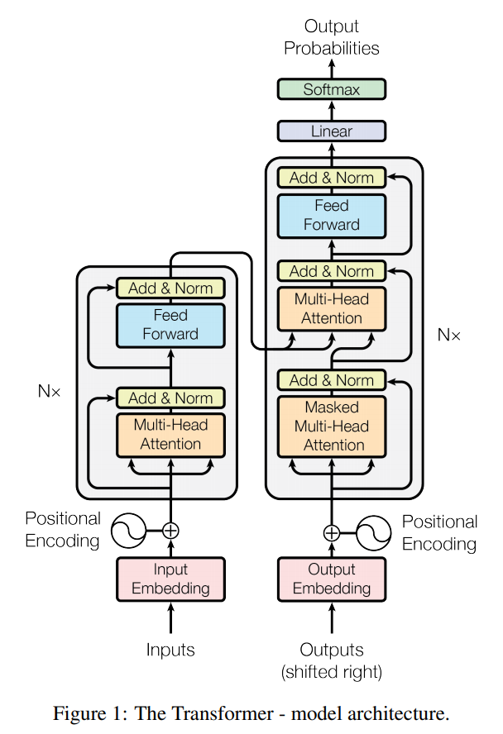
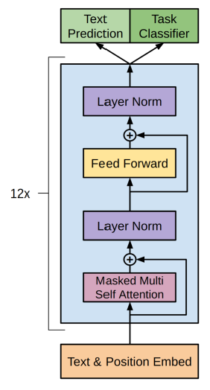
The rise of GPT
Improving Language Understanding by
Generative Pre-training (OpenAI, 2018)
Linear Layer for Pre-training
Linear Layer for Fine-tuning
Future Masking

Slide 11
Next token prediction & Fine-tuning
Generative Pre-trained Transformer (GPT)
Next token prediction: The way GPT understands human language
Step1. Self-supervised learning
Step2. Fine-tuning
am
groot
[eos]
positive
GPT
GPT
I
am
groot
I love you 3000
7

Slide 12
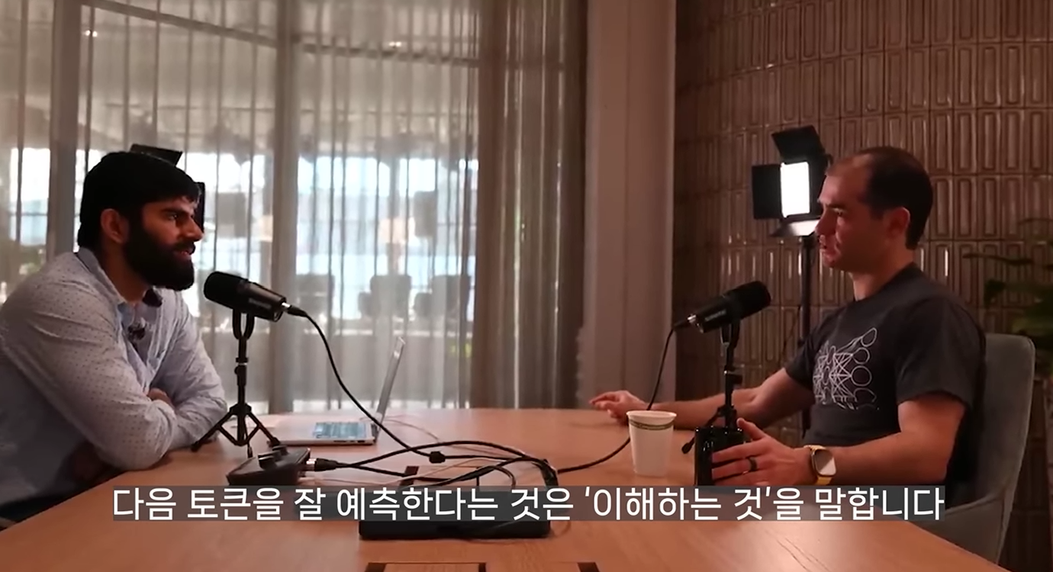
Interview
Ilya Sutskever (OpenAI Chief Scientist until 2024)
One of Geoffrey Hinton's prominent students
AlexNet, Seq2Seq, GPT, DALL-E, ...
“Large language models
transcend statistics,
showing deep
language understanding.”

Slide 13
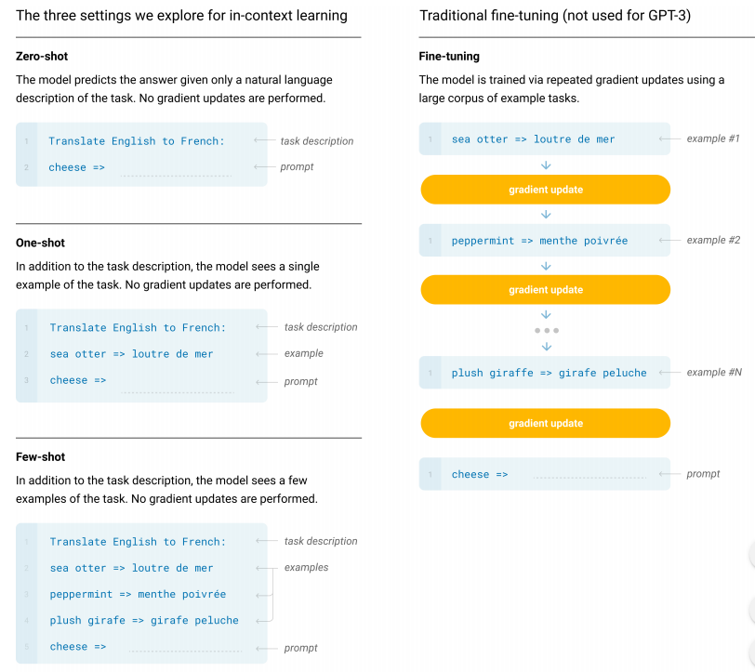

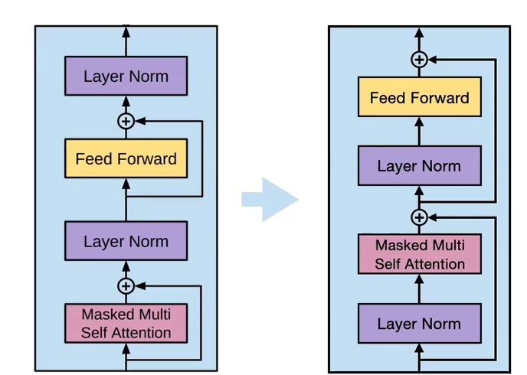
GPT-2 & GPT-3
No fine-tuning! Only next token prediction
A slight structural change
In-context learning

Slide 14
4. BERT
(Google, 2018)

Slide 15
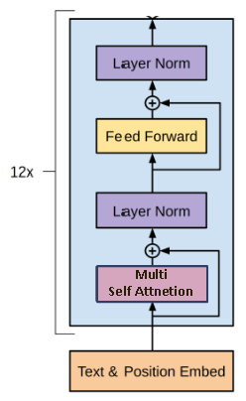
The rise of BERT
BERT: Pre-training of Deep Bidirectional Transformers for Language Understanding (Google, 2018)
No future
masking!

Slide 16
Masked token prediction
Bidirectional Encoder Representations from Transformers (BERT)
Masked token prediction: The way BERT understands human language
Step1. Self-supervised learning
Step2. Fine-tuning
I
am
groot
positive
BERT
BERT
I
<mask>
groot
I love you 3000

Slide 17
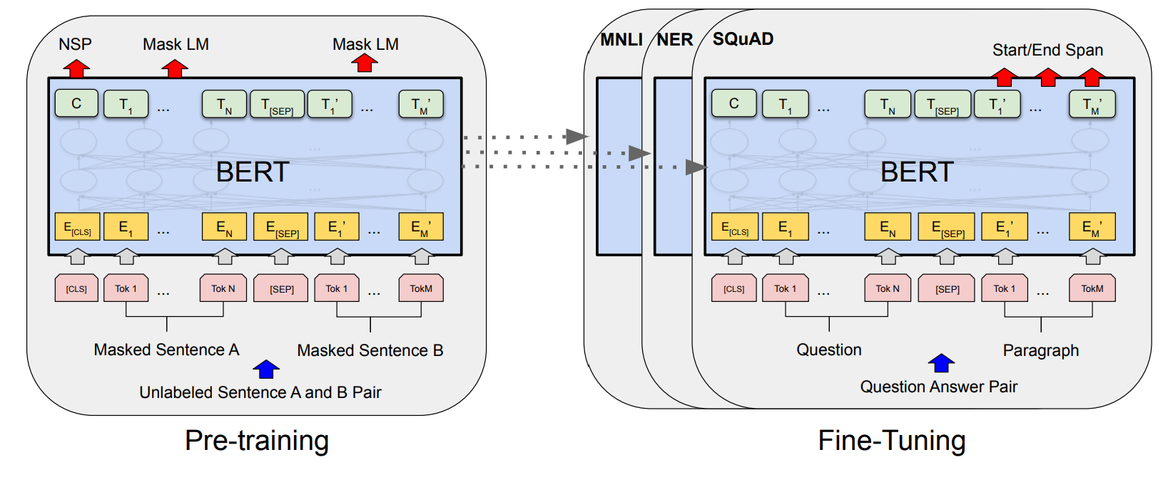
Pre-training of BERT
Masked token prediction (MTP) & Next sentence prediction (NSP)
Binary
classification

Slide 18
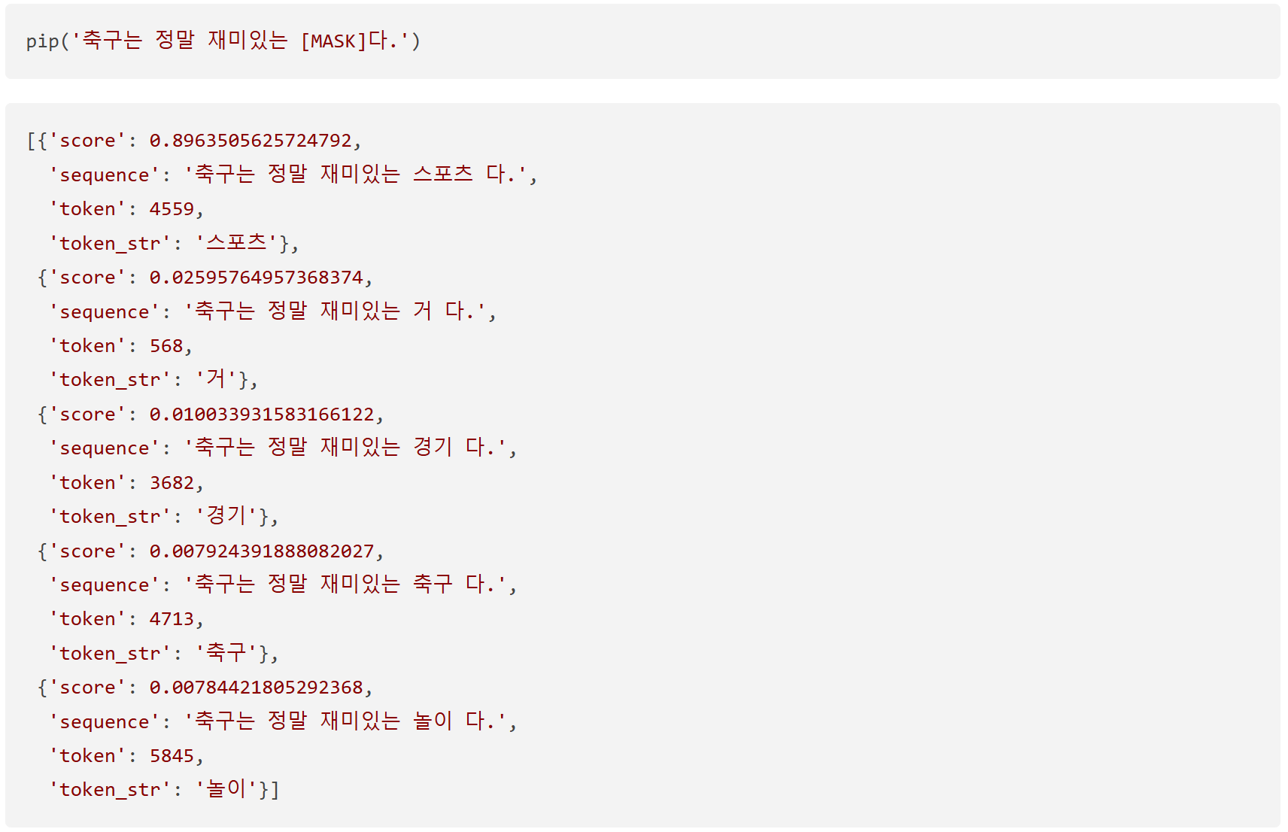
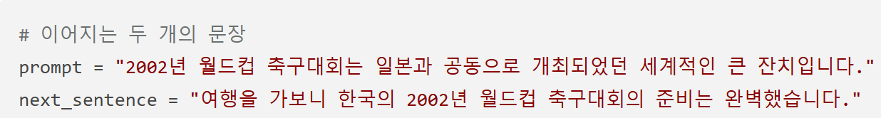
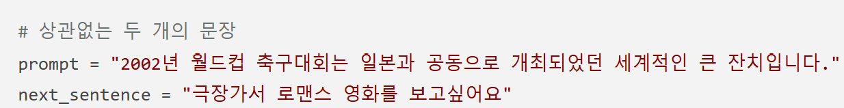
Experiments
Masked token prediction & Next sentence prediction
MTP
NSP (0: IsNext / 1: NotNext)
case 1
case 2

Slide 19
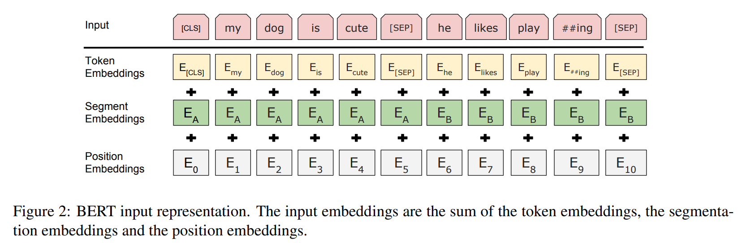
Embeddings of BERT
Three embeddings for BERT

Slide 20
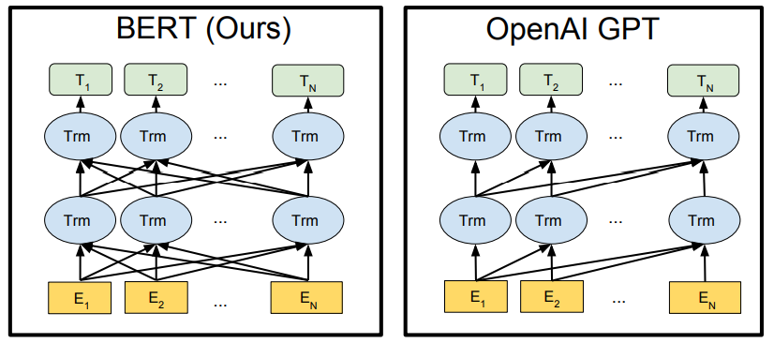
BERT vs GPT
Difference in future masking

Slide 21
5. Applications of GPT and BERT

Slide 22
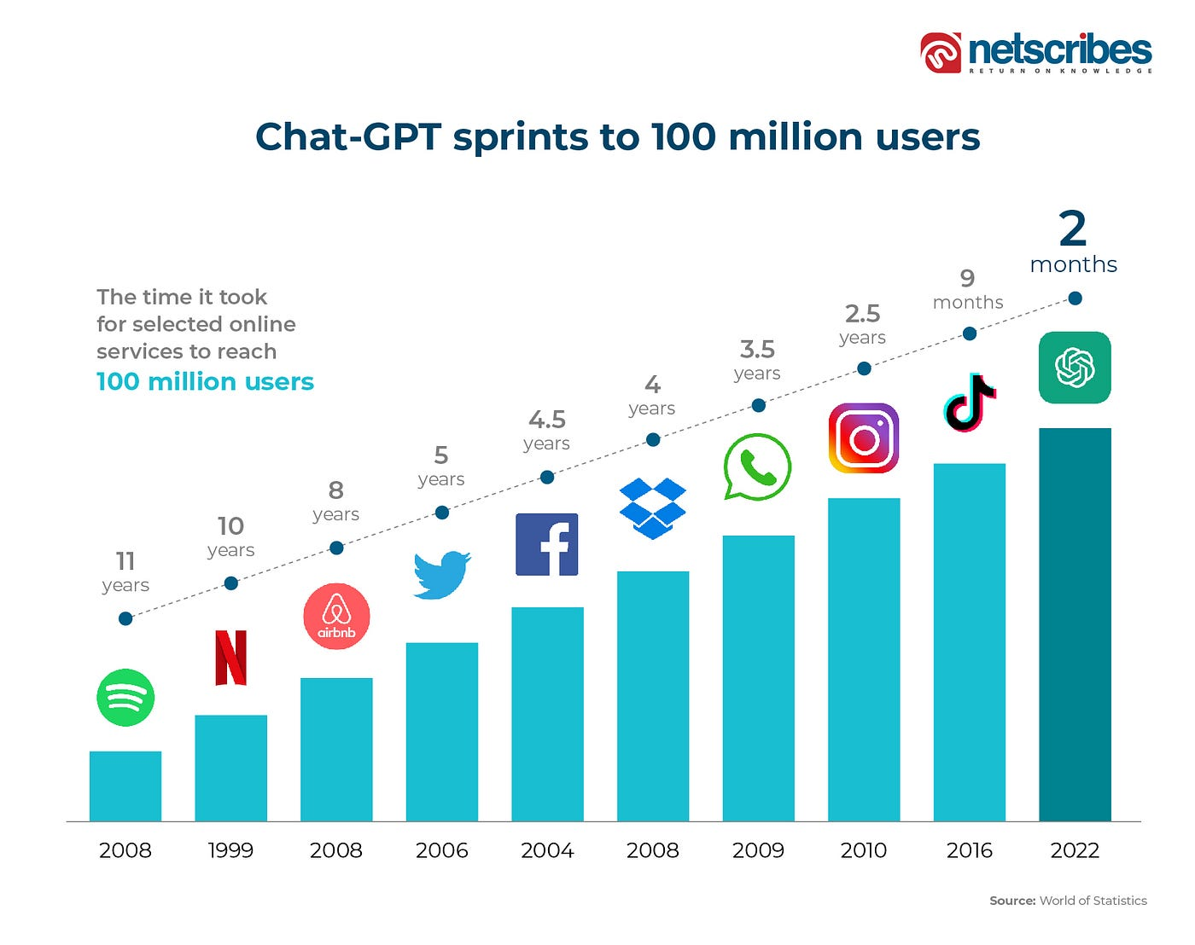
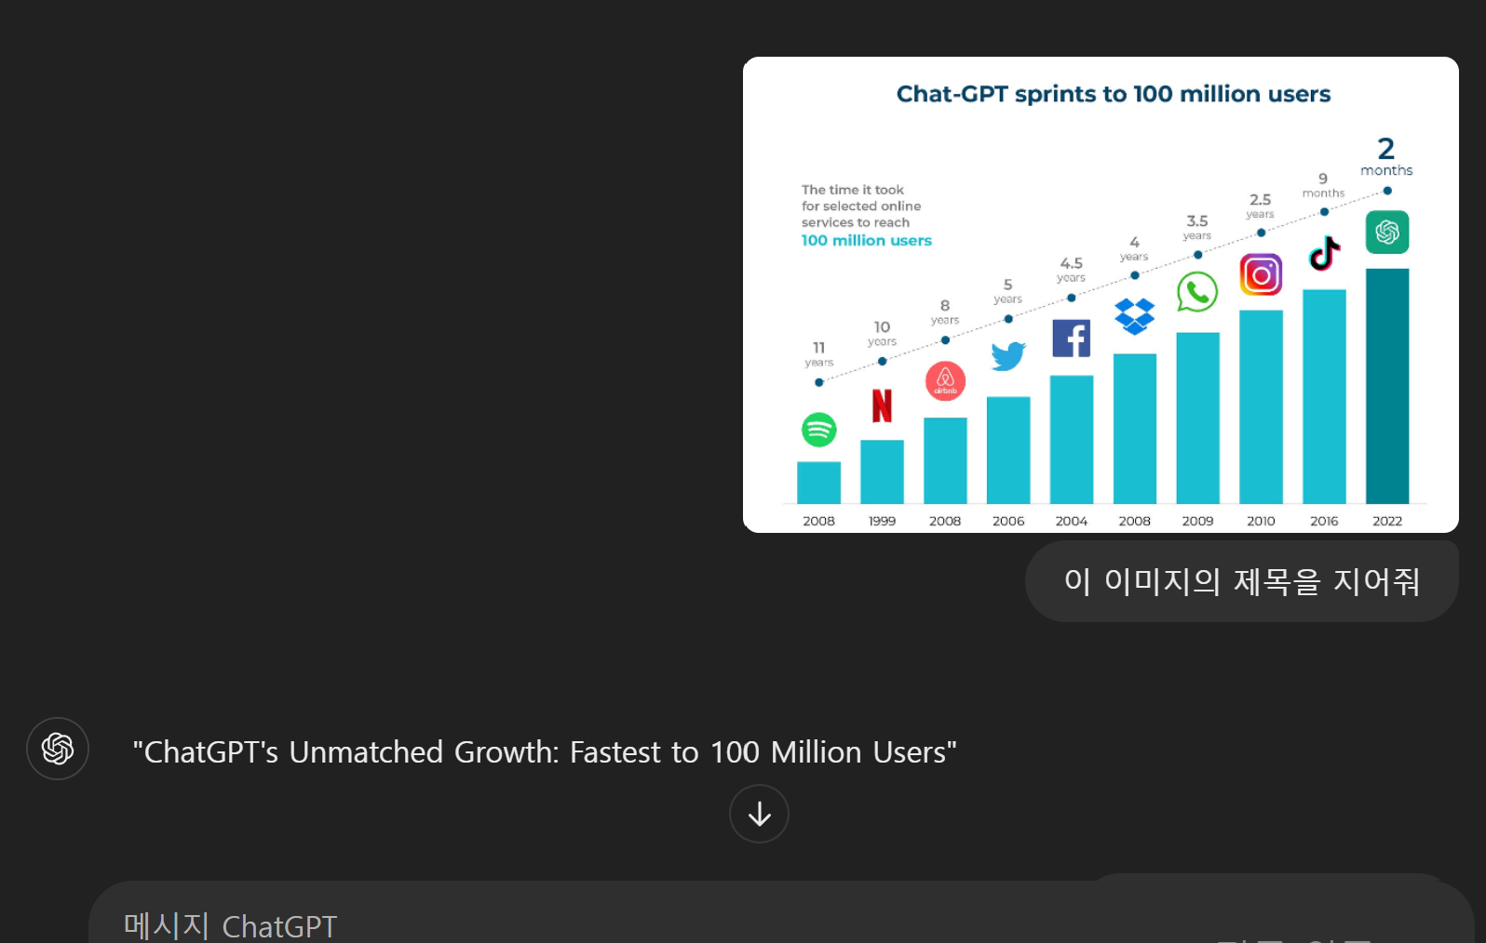
GPT’s application: ChatGPT
ChatGPT's unmatched growth: Fastest to 100 million users

Slide 23
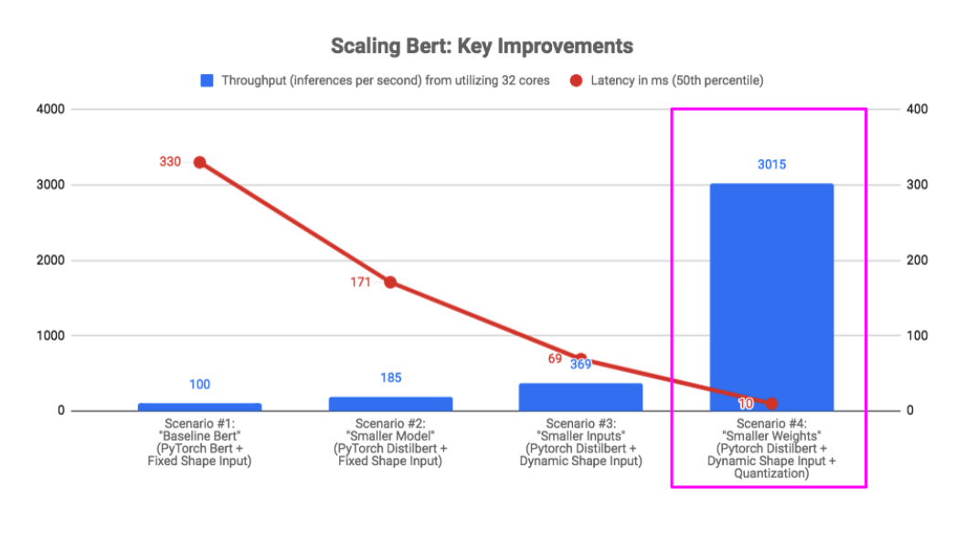
BERT's applications: ROBLOX
Optimizing BERT: Key improvements in ROBLOX

Slide 24
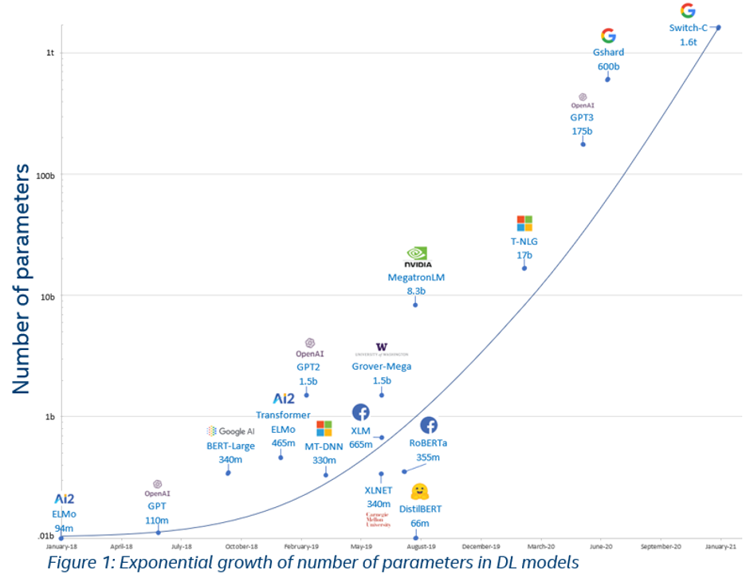
Development of LLM
The number of parameters
1.6조
1750억
15억
3.4억
3.5억
1.1억
0.6억

Slide 25
References
Radford, A., Narasimhan, K., Salimans, T., & Sutskever, I. (2018). Improving Language Understanding by Generative Pre-Training. OpenAI.
Devlin, J., Chang, M.-W., Lee, K., & Toutanova, K. (2018). BERT: Pre-training of Deep Bidirectional Transformers for Language Understanding. arXiv preprint arXiv:1810.04805.
Dai, A. M., & Le, Q. V. (2015). Semi-Supervised Sequence Learning. arXiv preprint arXiv:1511.01432.
Vaswani, A., Shazeer, N., Parmar, N., Uszkoreit, J., Jones, L., Gomez, A. N., Kaiser, Ł., & Polosukhin, I. (2017). Attention Is All You Need. In Advances in Neural Information Processing Systems (NeurIPS), 5998–6008.

Slide 26
Q&A

